Slide 1
Data 100 Lecture 5: Data Cleaning & Exploratory Data Analysis
?
Slides by:
Joseph E. Gonzalez, Deb Nolan, & Joe Hellerstein & Fernando Perez
jegonzal@berkeley.edu
deborah_nolan@berkeley.edu
hellerstein@berkeley.edu
fernando.perez@berkeley.edu

Slide 2
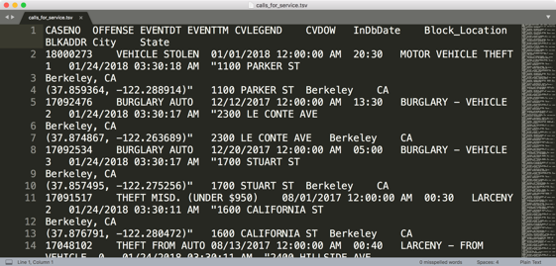
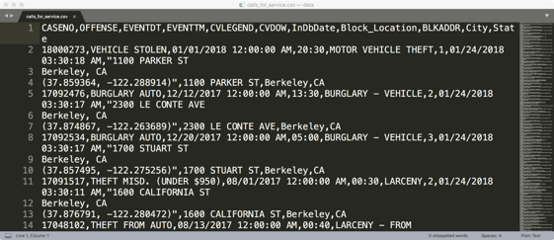
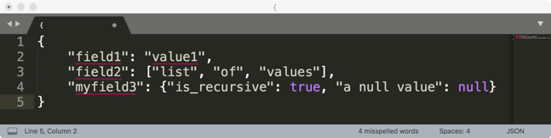
Last Lecture
Started discussing exploratory data analysis
Structure -- the “shape” of a data file (how is it organized)

Slide 3
Last Lecture
Started discussing exploratory data analysis
Structure -- the “shape” of a data file (how is it organized)
Granularity -- how fine/coarse is each datum
Rec. 1
Rec. 1
Rec. 2
Rec. 3
Rec. 1
Rec. 2
Rec. 3
Fine Grained
Coarse
Grained

Slide 4
Group By – manipulating granularity
Key
Data
A
3
A
3
A
1
Aggregate
Function
A
6
B
1
A
2
C
4
A
6
A
1
B
1
Split into
Groups
Merge
Results
B
12
B
5
B
5
Aggregate
Function
B
12
C
18
C
9
B
6
A
2
C
4
B
6
Aggregate
Function
C
9
C
18
C
5
C
5

Slide 5
Pivot – A kind of Group By Operation
Key R
Key
C
A
U
3
Data
Aggregate
Function
A
U
5
A
U
3
A
U
2
B
V
1
Aggregate
Function
A
V
1
U
V
A
V
1
A
1
C
U
4
Aggregate
Function
A
5
B
U
5
B
U
5
A
V
1
B
5
7
Split into
Groups
B
V
1
Aggregate
Function
B
V
7
B
U
5
C
4
9
B
V
6
C
V
9
D
5
C
U
4
Aggregate
Function
C
U
4
A
U
2
Need to address missing values
C
V
9
Aggregate
Function
C
V
9
B
V
6
D
U
5
D
U
5
Aggregate
Function
D
U
5

Slide 6
Last Lecture
Started discussing exploratory data analysis
Structure -- the “shape” of a data file (how is it organized)
Granularity -- how fine/coarse is each datum
Scope -- how (in)complete is the data
Population
Data
Population
Data
Need to Filter
Need to Filter
Need more data

Slide 7
Last Lecture
Started discussing exploratory data analysis
Structure -- the “shape” of a data file (how is it organized)
Granularity -- how fine/coarse is each datum
Scope -- how (in)complete is the data
Temporality -- how is the data situated in time

Slide 8
Demo
http://abcnews.go.com/Lifestyle/silly-baby-panda-falls-flat-face-public-debut/story?id=42481478

Slide 9
Key Data Properties to Consider in EDA
Structure -- the “shape” of a data file
Granularity -- how fine/coarse is each datum
Scope -- how (in)complete is the data
Temporality -- how is the data situated in time
Faithfulness -- how well does the data capture “reality”

Slide 10
Scope
Does my data cover my area of interest?
Example: I am interested in studying crime in California but I only have Berkeley crime data.
Is my data too expansive?
Example: I am interested in student grades for DS100 but have student grades for all statistics classes.
Solution: Filtering → Implications on sample?
If the data is a sample I may have poor coverage after filtering …
Does my data cover the right time frame?
More on this in temporality …

Slide 11
Temporality
Data changes → When was the data collected!
What is the meaning of a the time and date fields?
When the “event” happened?
When the data was collected or was entered into the system?
Date the data was copied into a database (look for many matching timestamps)
Time depends on where! (Time zones & daylight savings)
Learn to use datetime python library
Multiple string representation (depends on region): 07/08/09?
Are there strange null values?
January 1st 1970, January 1st 1900
Is there periodicity? Diurnal patterns

Slide 12
Unix Time / POSIX Time
Time measured in seconds since January 1st 1970
Minus leap seconds …
Unix time follows Coordinated Universal Time (UTC)
International time standard
Measured at 0 degrees latitude
Similar to Greenwich Mean Time (GMT)
No daylight savings
Time codes
Time Zones:
San Francisco (UTC-8) without daylight savings
https://en.wikipedia.org/wiki/Coordinated_Universal_Time
Notes:
Year 2038 problem → 32 bit signed time wraps around.

Slide 13
Key Data Properties to Consider in EDA
Structure -- the “shape” of a data file
Granularity -- how fine/coarse is each datum
Scope -- how (in)complete is the data
Temporality -- how is the data situated in time
Faithfulness -- how well does the data capture “reality”

Slide 14
Key Data Properties to Consider in EDA
Structure -- the “shape” of a data file
Granularity -- how fine/coarse is each datum
Scope -- how (in)complete is the data
Temporality -- how is the data situated in time
Faithfulness -- how well does the data capture “reality”

Slide 15
Faithfulness: Do I trust this data?
Does my data contain unrealistic or “incorrect” values?
Examples?
Dates in the future for events in the past
Locations that don’t exist
Negative counts
Misspellings of names
Large outliers
Does my data violate obvious dependencies?
E.g., age and birthday don’t match
Was the data entered by hand?
Spelling errors, fields shifted …
Did the form require fields or provide default values?
Are there obvious signs of curb stoning (data falsification):
Repeated names, fake looking email addresses, repeated use of uncommon names or fields.

Slide 16
Signs that your data may not be faithful
Missing Values/Default values: (0, -1, 999, 12345, NaN, Null, 1970, 1900, … others?)
Soln 1: Drop records with missing values → implications on your sample!
Soln 2: Impute missing values → Bias your conclusions
Time Zone Inconsistencies
Soln 1: convert to a common timezone (e.g., UTC)
Soln 2: convert to the timezone of the location – useful in modeling behavior.
Duplicated Records or Fields
Soln: identify and eliminate (use primary key) → implications on sample?
Spelling Errors
Soln: Apply corrections or drop records not in a dictionary → implications on sample?
Units not specified or consistent
Solns: Infer units, check values are in reasonable ranges for data
Truncated data (early excel limits: 65536 Rows, 255 Columns)
Soln: be aware of consequences in analysis → how did truncation affect sample?
Others…
Notes:
Negative numbers, large outliers, failed parsing …

Slide 17
How do you do EDA?
Examine data and meta-data:
What is the date, size, organization, and structure of the data?
Examine each field/attribute/dimension individually
Examine pairs of related dimensions
Stratifying earlier analysis: break down grades by major …
Along the way:
Visualize/summarize the data
Validate assumptions about data and collection process
Identify and address anomalies
Apply data transformations and corrections
Record everything you do! (why?)

Slide 18
Visualization and EDA

Slide 19
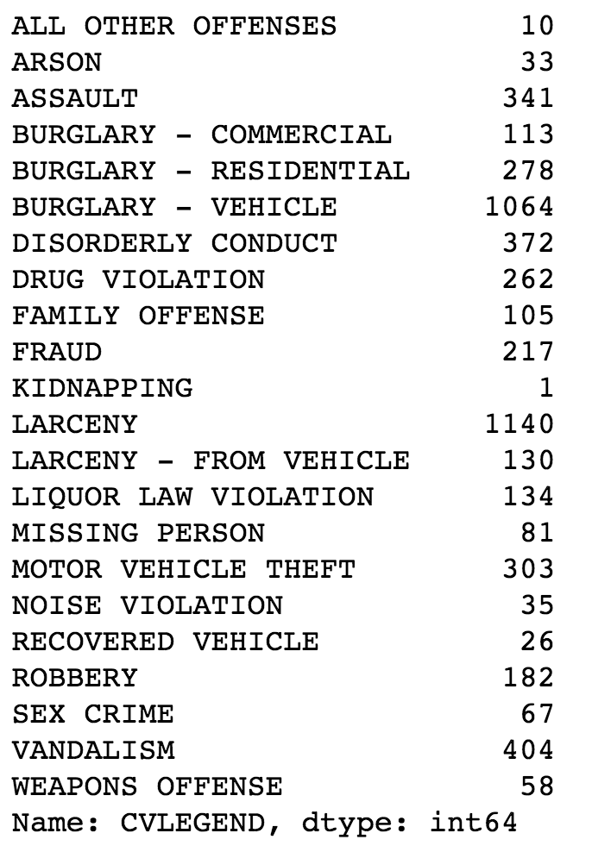
Berkeley Crime Data
Which helps identify key patterns in the data?

Slide 20
Visualizing Univariate Relationships
Quantitative Data
Histograms, Box Plots, Rug Plots, Smoothed Interpolations (KDE – Kernel Density Estimators)
Look for spread, shape, modes, outliers, unreasonable values …
Nominal & Ordinal Data
Bar plots (sorted by frequency or oridinal dimension)
Look for skew, frequent and rare categories, or invalid categories
Consider grouping categories and repeating analysis

Slide 21
Histograms, Rug Plots, and KDE Interpolation
Describes distribution of data – relative prevalence of values
Histogram
relative frequency of values
Tradeoff of bin sizes
Rug Plot
Shows the actual data locations
Smoothed density estimator
Tradeoff of “bandwidth” parameter (more on this later)
Main Mode
Smoothed Density Estimator
Second Mode
Skew Right
Histogram
Outliers
Gap
Rug

Slide 22
Box Charts
Useful for summarizing distributions and comparing multiple distributions
Outliers
Outliers are 1.5 * IQR away from lower and upper quartiles.
(in some implementations, others use 3*IQR, …)
Whisker
Upper Quartile
Interquartile
Range (IQR)
50% of Data
Median
Lower Quartile
Notes:
(1) Friday non-smokers seem to have higher bills

Slide 23
Bar Charts
Used to compare nominal and ordinal data.
Consider sorting by category or frequency
Titanic
Passenger
Manifest
Class
Sex
Survived

Slide 24
Visualizing Multivariate Relationships
Conditioning on a range of values (e.g., ages in groups) and construct side by side box-plots or bar charts
Comparison of Restaurant Bills
Titanic Survivors

Slide 25
http://bit.ly/ds100-sp18-???
Comparison of Restaurant Bills
Titanic Survivors

Slide 26
Berkeley Police Data Demo

Slide 27
Berkeley Police Public Datasets
Question: For this analysis we will not begin with a detailed question but instead a rough goal of understanding Police activity.
Examine Two Data Sets:
Call data
Stop data
Today we will work through the basic process of data loading, some preliminary cleaning, and exploratory data analysis.

Slide 28
Call Data Description
Data pulled from Public Safety Server using data created for Berkeley’s Crime View Community page. Displays incidents reported for the last 180 days along with time, date, day of week and block level location information.
The dataset reflects crimes as they have been reported to the BPD based on preliminary information supplied by the reporting parties. Preliminary crime classifications may change based on follow-up investigations. Not all calls for police service are included (e.g. Animal Bite). The information provided on this site is intended for use by the community to enhance their awareness of crimes occurring in their neighborhoods and the entire City. The data should not be used for in-depth crime analysis as the initial information is subject to change.

Slide 29
Stops Data Description
This data was extracted from the Department’s Public Safety Server and covers the data beginning January 26, 2015. On January 26, 2015 the department began collecting data pursuant to General Order B-4 (issued December 31, 2014). Under that order, officers were required to provide certain data after making all vehicle detentions (including bicycles) and pedestrian detentions (up to five persons). This data set lists stops by police in the categories of traffic, suspicious vehicle, pedestrian and bicycle stops. Incident number, date and time, location and disposition codes are also listed in this data.
Address data has been changed from a specific address, where applicable, and listed as the block where the incident occurred. Disposition codes were entered by officers who made the stop. These codes included the person(s) race, gender, age (range), reason for the stop, enforcement action taken, and whether or not a search was conducted.

Slide 30
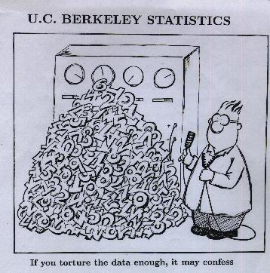
Caution about EDA
With enough data, if you look hard enough you will find something “interesting”
Important to differentiate inferential conclusions about world from exploratory analysis of data

Slide 31
Go Play!
There’s data out there…

Slide 32
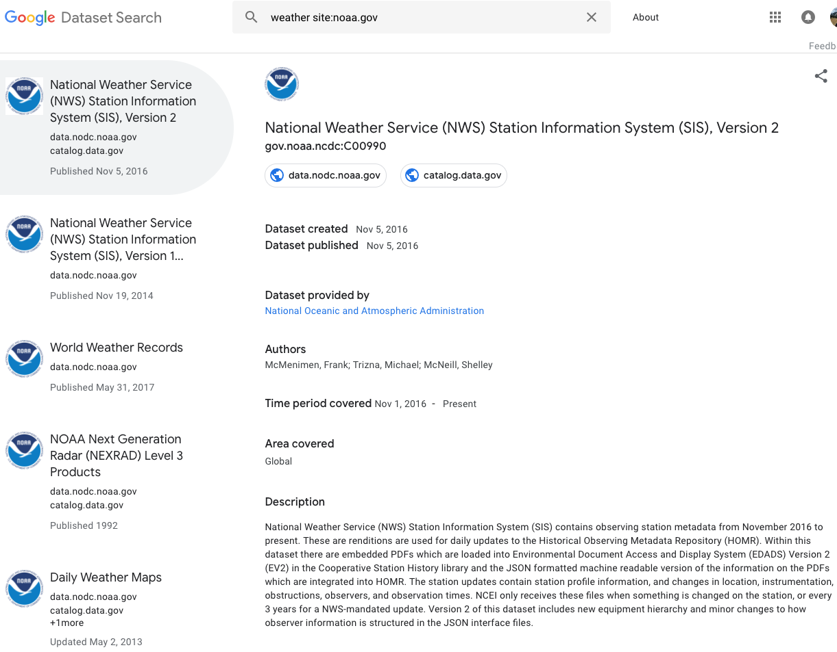
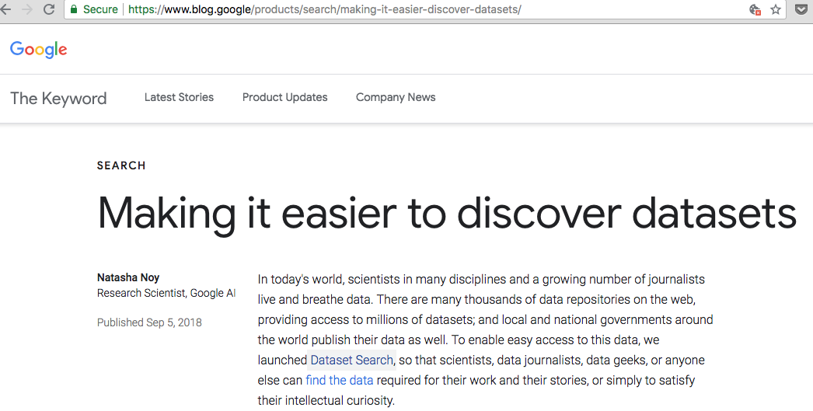
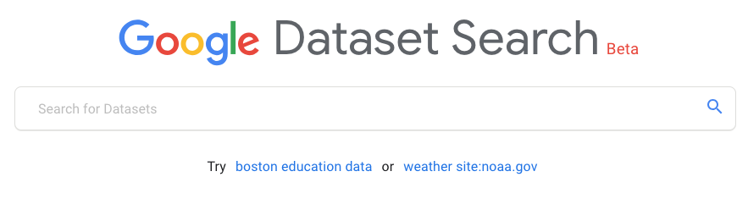
Today: Google’s dataset search
https://toolbox.google.com/datasetsearch

Slide 33
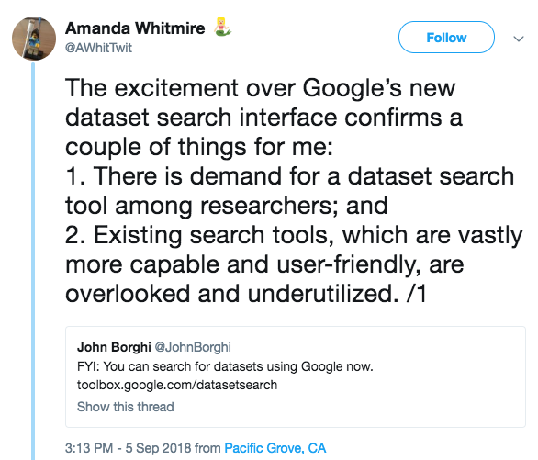
Not the only one!
https://twitter.com/AWhitTwit/status/1037463720920670208

Slide 34
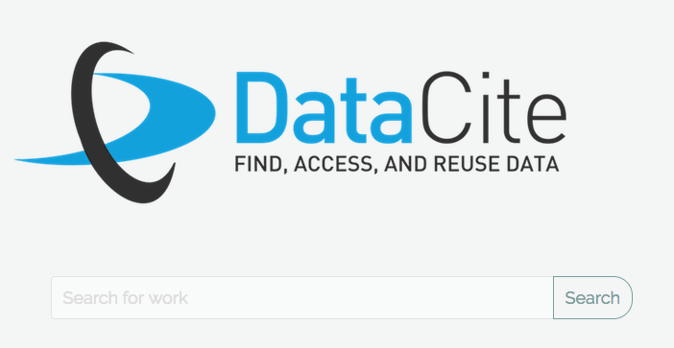
DataCite: datasets with a DOI
Search all datasets with DOI
DOI: Digital Object Identifier
Search cuts across many repositories
Metadata somewhat generic
https://search.datacite.org

Slide 35
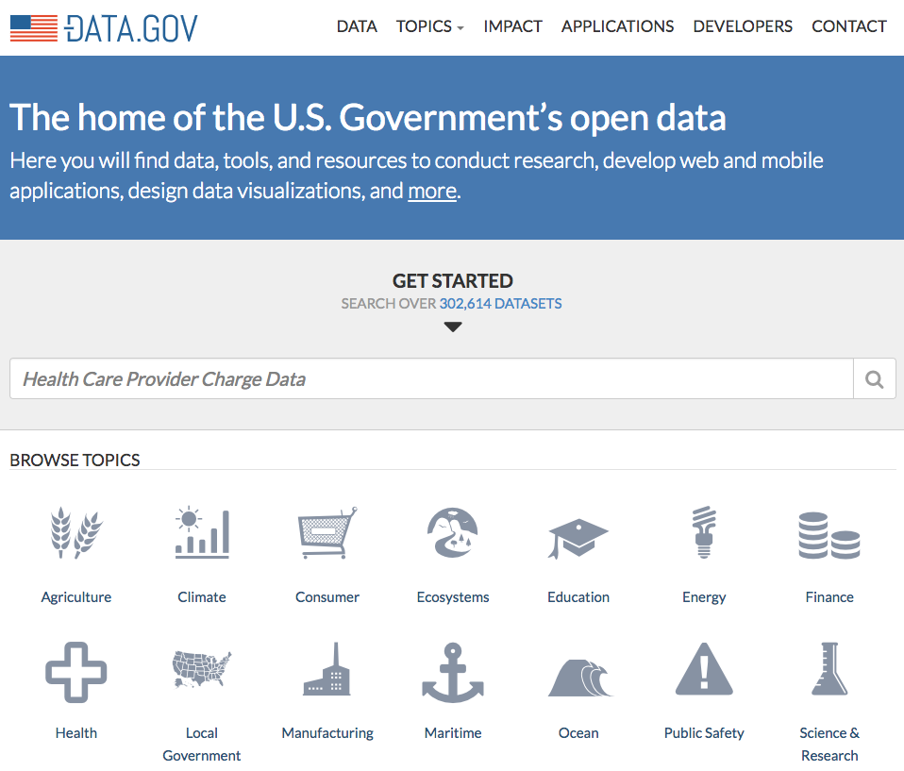
data.gov: over 300k datasets
Official US government data
City
State
Federal
Tribal…

Slide 36
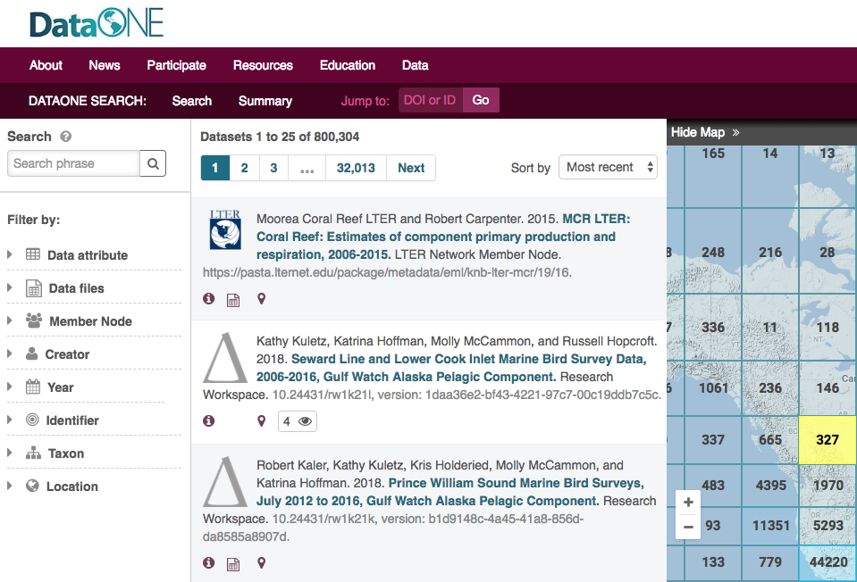
DataONE
Environmental science focus
Federated repository search
Data Provenance
Location search
https://search.dataone.org/data

Slide 37
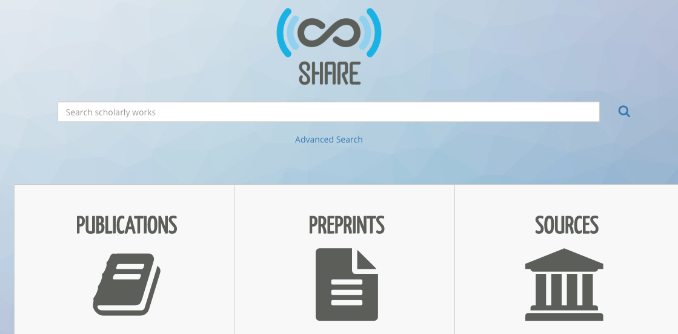
SHARE – Association of Research Libraries & Center for Open Science
https://share.osf.io

